Slide 1




Make Lightning more 'Eventful' using oAuth based Integration
Mohammed Rizwan
Senior Salesforce Developer
Standav Digital

Slide 2
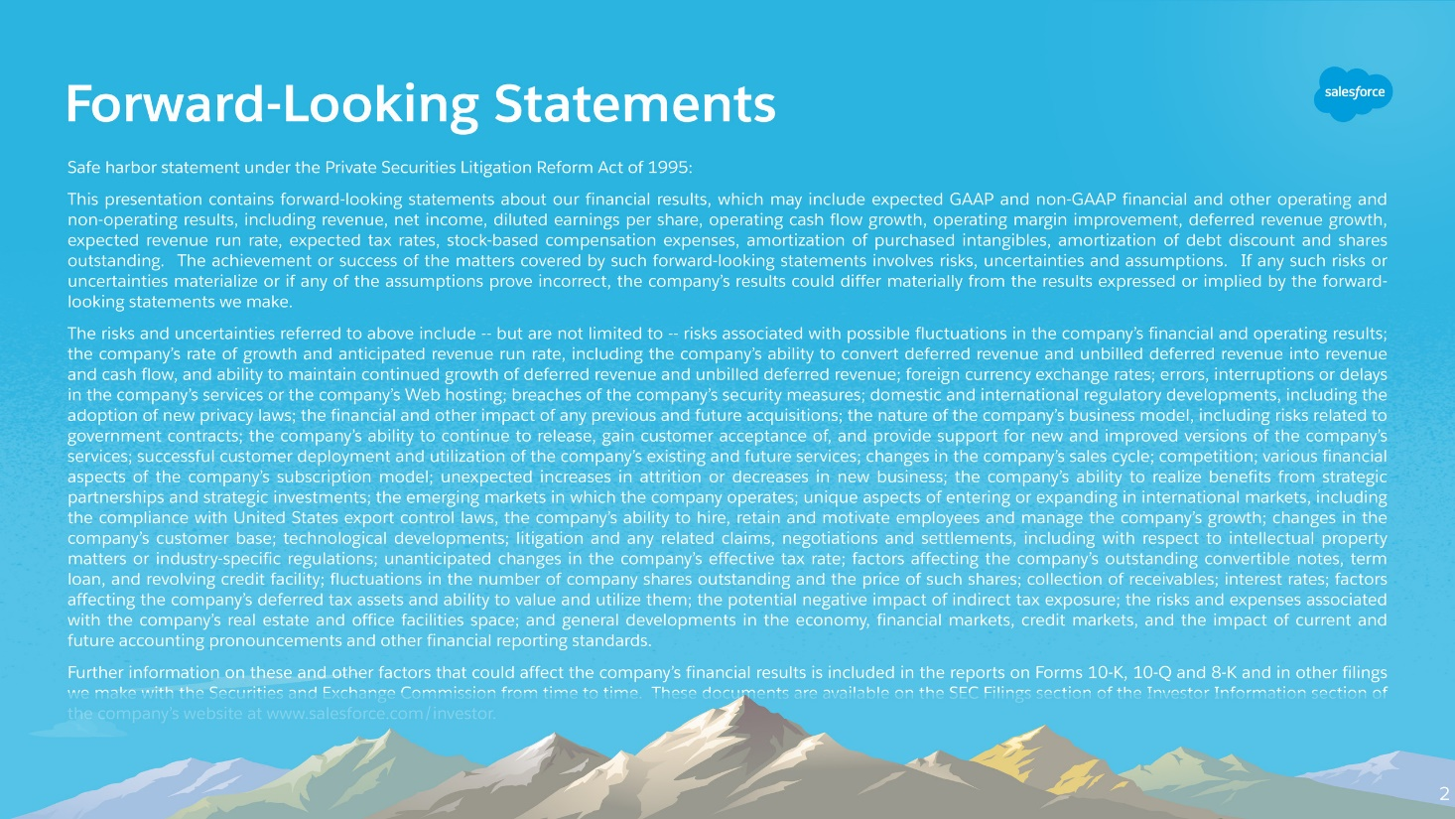

Slide 3
Agenda
Use Case
Building Blocks
Code Sample
Demo
Q&A

Slide 4
Use Case
Sales in High Tech Industry take months of time to conclude
Sales Reps need to know what their leads are doing
Keep a close look at your competitors
Knowing your clients and your competitors is of utmost importance to increase your sales

Slide 5
Building Blocks
Custom Object(s)
Custom Metadata
Apex Classes
Lightning Components
Test Classes

Slide 6
Code Sample

Slide 7
Demo

Slide 8



Q&A
For more info:
@rizwanakhtar08
/mritizi/IndiaDreamIn18
contact@mdrizwan.com

Slide 9


